Slide 1
CSEE5590/CS490-0004: AI for Cybersecurity
Gharib Gharibi
Summer 2019

Slide 2
Instructor
Gharib Gharibi
ggk89@mail.umkc.edu (preferred)
Office: FH 519 (TuTh 3-4pm) or by appointment

Slide 3
Course: AI for Cybersecurity
AI, and specifically Deep Learning, has advanced the SOTA in an growing number of domains.
Thus, there is a high demand to develop DL models, but the privacy and security of these models have been ignored for some extent.
We study how to secure DL models and preserve data privacy when developing and implementing DL models.

Slide 4
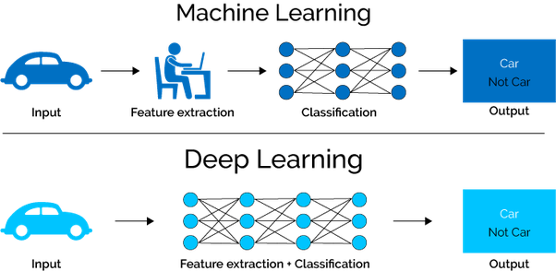
What is Deep Learning?
A subfield of Machine Learning that can automatically detect the features/patterns of data without user intervention.

Slide 5
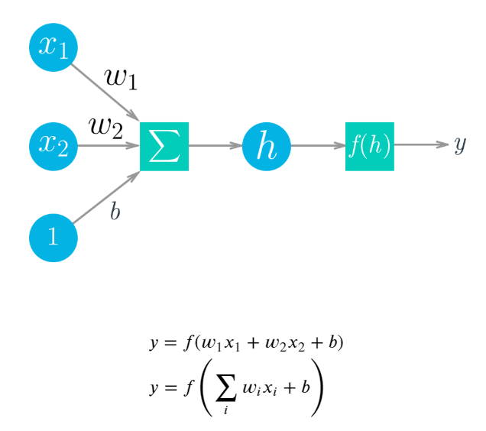
Neural Networks
Deep Learning is based on artificial neural networks which have been around in some form since the late 1950s.
The networks are built from individual parts approximating neurons, typically called units or simply "neurons."
Referece: https://classroom.udacity.com

Slide 6
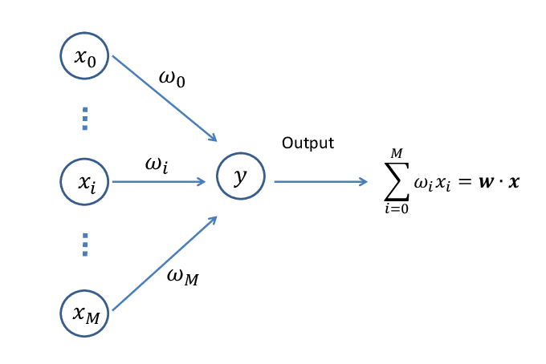
One-Layer Neural Network: How does it work?

Slide 7
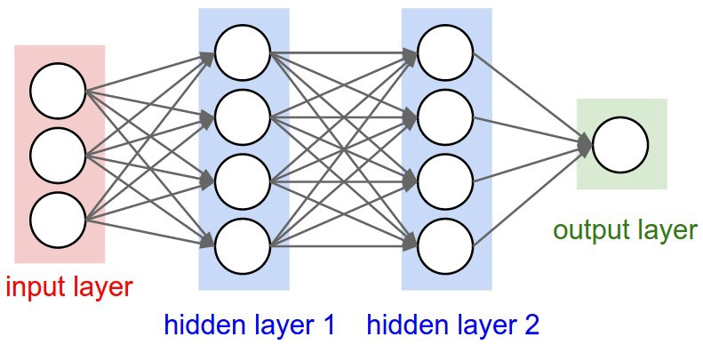
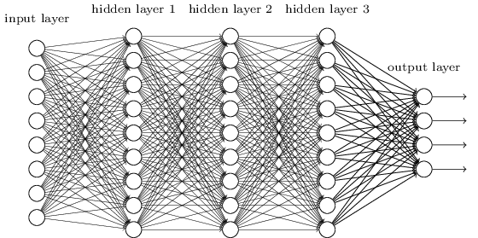
The General Architecture of a Deep Neural Network
More hidden layers for more complicated tasks (NLP, Computer Vision, etc.)

Slide 8
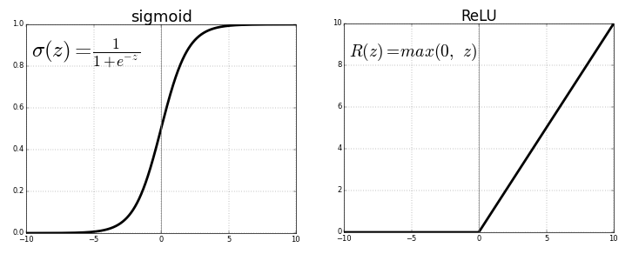
Activation Functions
Used to break the linearity of the matrix computations by compressing the network values between 0 and 1 or -1 and 1.
ReLU
Sigmoid
Tanh
Softmax

Slide 9
More on Deep Neural Networks
Do not worry about these concepts, we will study them in more details as the course progress (top-down appraoch):
A loss function (e.g., mean square error)
Backpropagation
Stochastic Gradient Descent
Hyperparameters
…and others

Slide 10
Google Colaboratory
Google Colab is an online Notebook service with that provides a GPU for up to 12 hours per session for free.
You only need to create a Google account (gmail) and access the GC from your Google Drive.
Here’s the formal “getting-Started” tutorial from Google:
https://colab.research.google.com/notebooks/welcome.ipynb
We will run this step-by-step in the class

Slide 11
Introduction to PyTorch
What is PyTorch?
PyTorch Locally:
To install PyTorch Locally, follow the instructions here: https://pytorch.org/get-started/locally/
You should be able to manage Virtual Environment on your own system. I recommend using Conda. Follow the instructions here: https://conda.io/en/latest/
Install NumPy and Jupyter Notebooks (should be easy to install from within conda –if not already installed with the package)

Slide 12
Introduction to PyTorch
If you do not have a local GPU, I recommend using Google Colaboratory. https://colab.research.google.com/notebooks/welcome.ipynb
If you would like to use other paid services, check:
AWS: https://docs.aws.amazon.com/dlami/latest/devguide/gpu.html
GCP: https://cloud.google.com/gpu/
FolydHub: https://www.floydhub.com/

Slide 13
Introduction to PyTorch
The best resource to start learning PyTorch, is to learning by example from the following Notebooks on GitHub (these are used for teaching a Deep Learning Nanodegree in Udacity). Following is a modified version to fit our classroom.
Clone the following repository (It includes more teaching materials and ICP 1):
https://app.box.com/file/469880222759

Slide 14
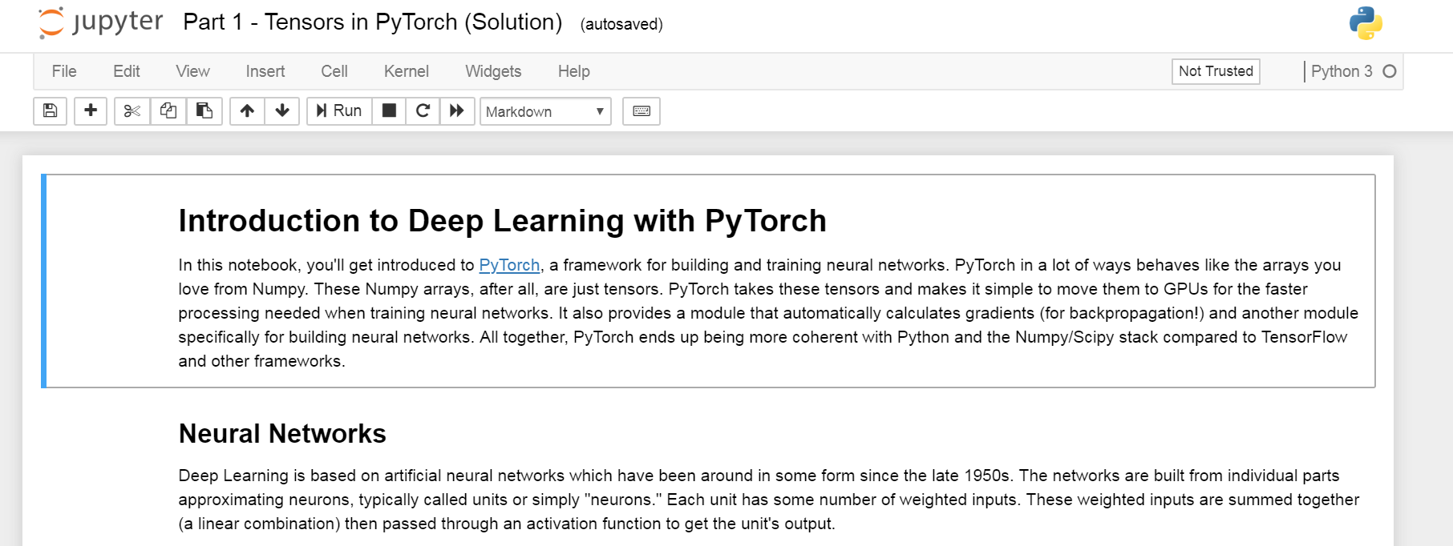
Building a Deep Neural Network (DNN) from scratch:
Notebook1:
deep-learning-v2-pytorch >> intro-to-PyTorch >> Part1 (tensors in PyTorch)

Slide 15
ICP1 (Exercise Part1 + Part2) Part 1: Build a DNN using Tensors Part2: Build a DNN using PyTorch nn module and download the MNIST dataset

